Slide 1
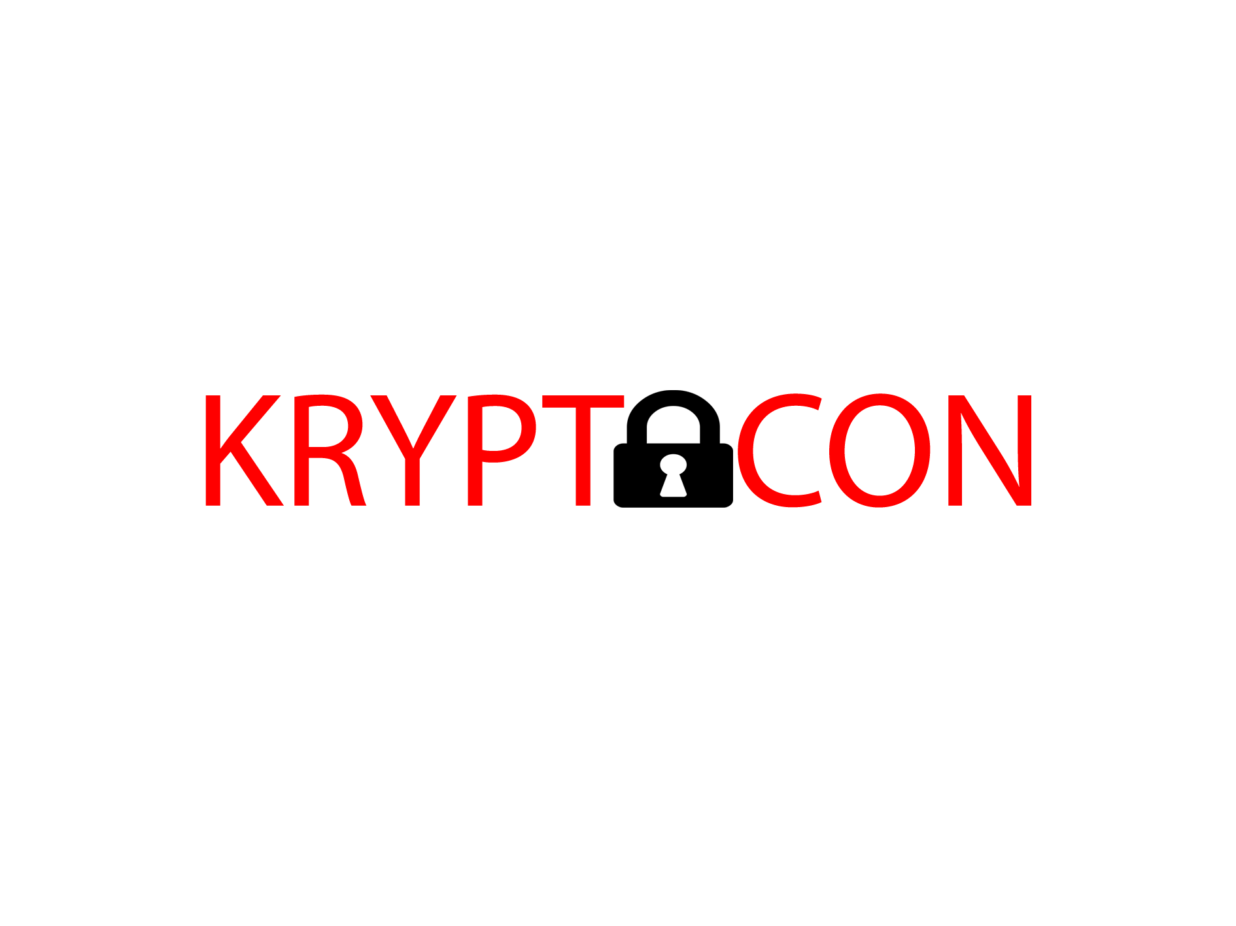
CTIS165 PROJECT
Rafeh Hussain
Bertan Özer
Berkan Bubik

Slide 2

Brief Description
FREE. SECURE. NO ADS.
An open-source messaging application where all your messages and calls are end-to-end (E2E) encrypted.
Kryptocon can be used anonymously: it does not require your phone number or email for account registration.

Slide 3

Brief Description
Every user is assigned a random ‘Krypto ID’.
Chat messages are not stored on server and deleted immediately after delivery to recipient.
User data is never used for advertising purposes.
There are no hidden backdoors.

Slide 4

Potential Users
People who are concerned about their online privacy and how personal data is being accessed by advertisers and governments can use this platform

Slide 5
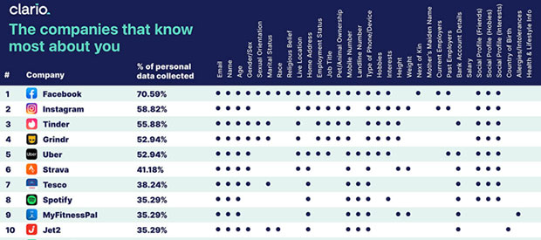

Slide 6

Functions of the System
TPS
MIS
DSS
ESS

Slide 7
Benefits and Advantages
Safe and Secure Communication
Privacy: Talk freely with your friends and family
Freedom of Expression
No Censorship
No Ads

Slide 8




HARDWARE

Slide 9




SOFTWARE

Slide 10
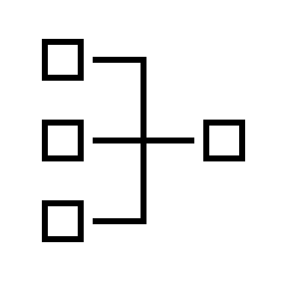



Networking and Communication Technologies

Slide 11
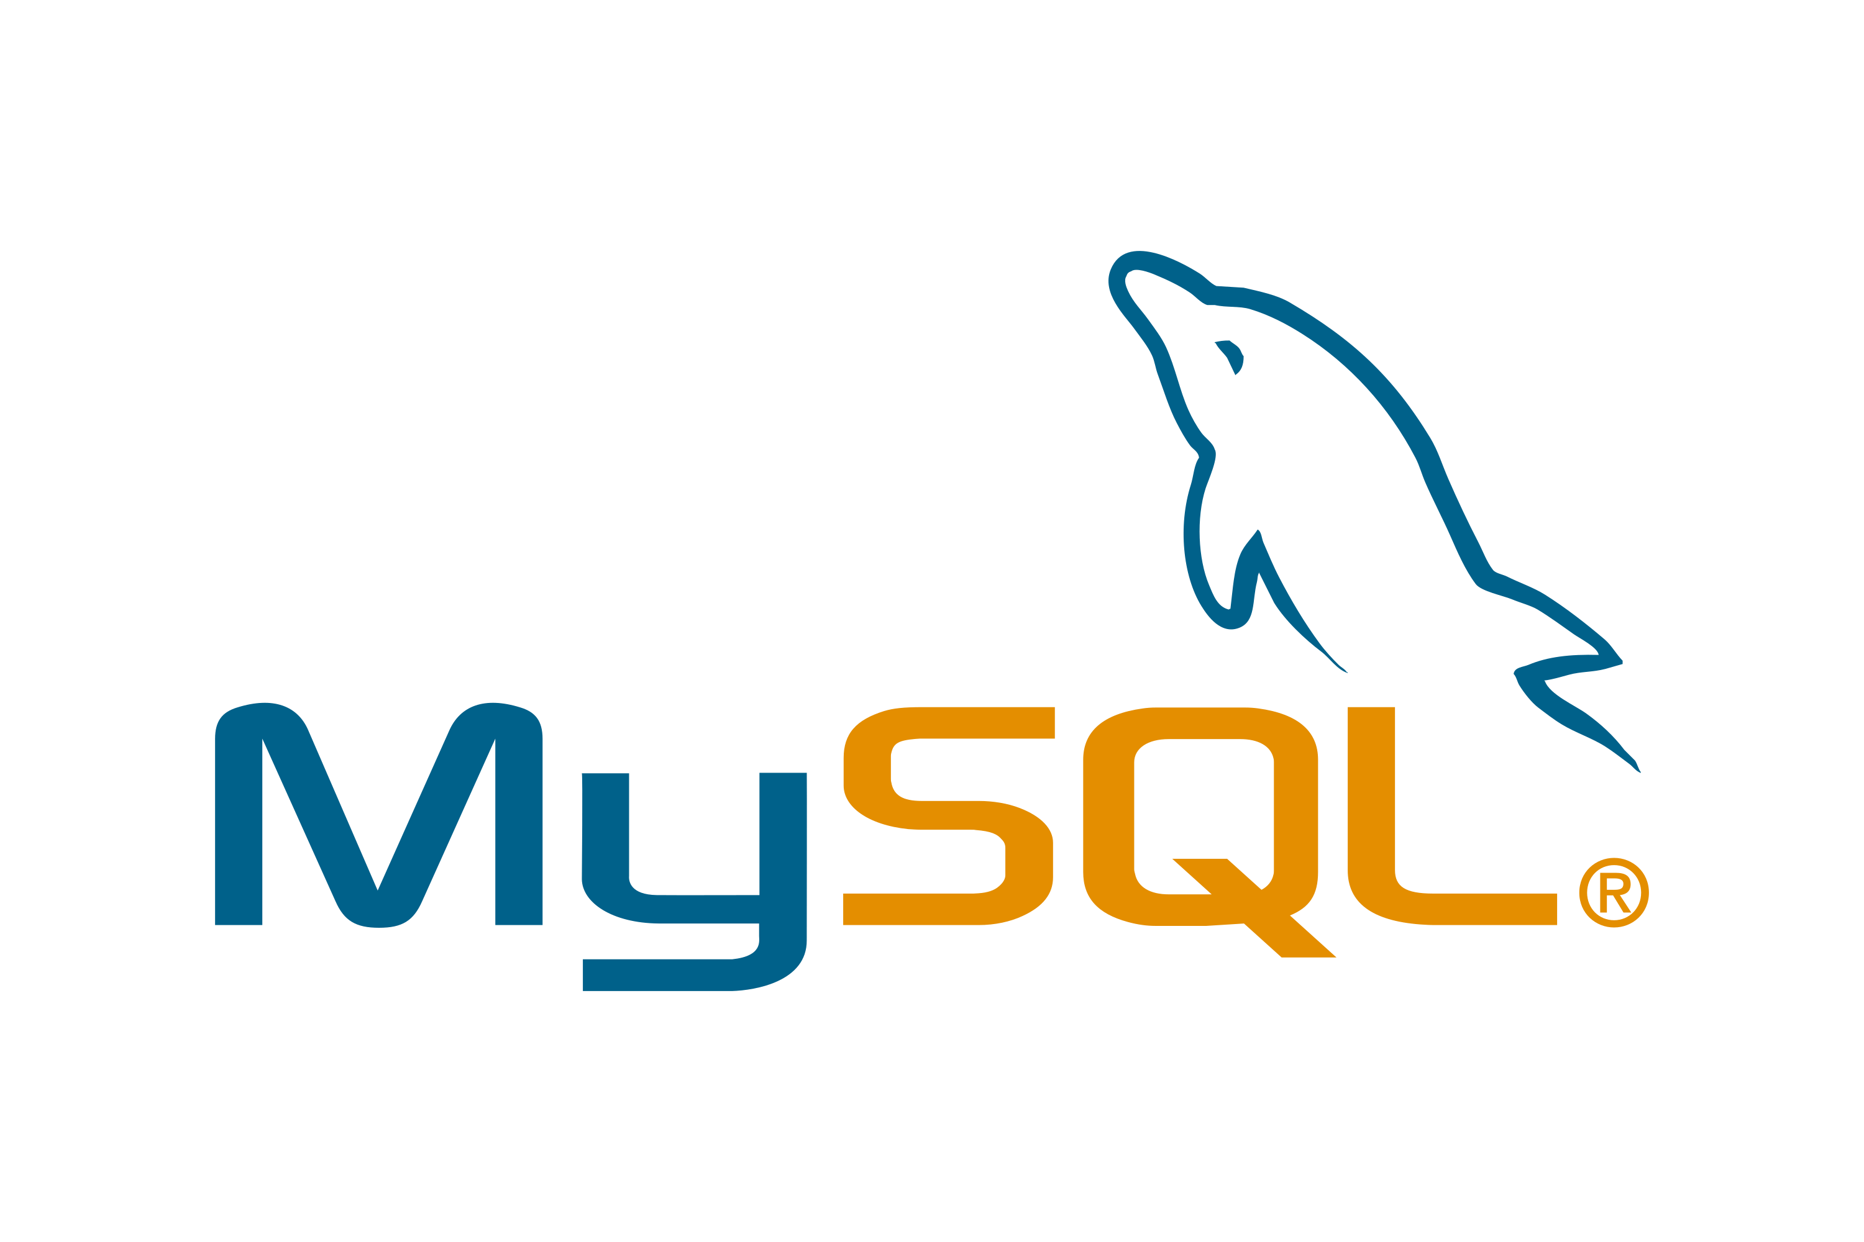
Data Management and Storage

Slide 12

Ethical or Social Issues
QUALITY – This project should meet highest possible quality standards by using the most advanced encryption algorithms.
INFORMATION – This project should tell users that it does not collect or store any personally identifiable user data or content of any of the messages.
PROFESSIONALISM – The project should fulfill its claims of no advertisement and free usage of most features.

Slide 13

Security Issues
SECURITY – The servers and database in use are fully encrypted with no unauthorized access possible. The application is open-source and users can analyze the source code to examine the security mechanisms.
PRIVACY – This project puts utmost emphasis on privacy. All messages are fully encrypted with public/private key pairs and the private key is only stored on the user device.

